Slide 1


Powerful Pulleys

Slide 2
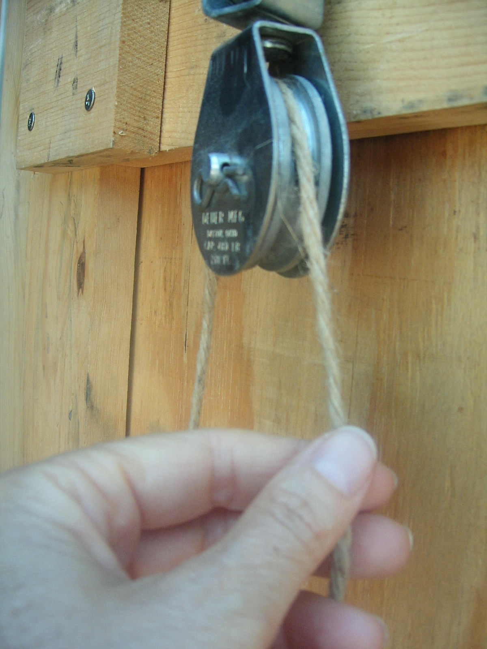
What is a pulley?
A pulley is a wheel
A pulley uses rope that goes around the wheel (often in a groove)
The rope attaches to objects
The other end of the rope has a force applied
Applied force is a push or pull

Slide 3
Fixed Pulley
Force
Rope
Fixed Pulley
Object moves
Pulley stays in the same spot
Force applied only on one end of the rope
Weight

Slide 4
Moveable Pulley
Reaction
Force
Rope
Force
Movable Pulley
Pulley is attached to object
Pulley and object move together
Rope is attached to something that does not move
Force applied to other end of rope
Pulley
Weight

Slide 5

Who has seen pulleys?
…Pulleys are all around us…
⬅ Elevator
Flagpole ➔
⬅ Window shades and blinds

Slide 6

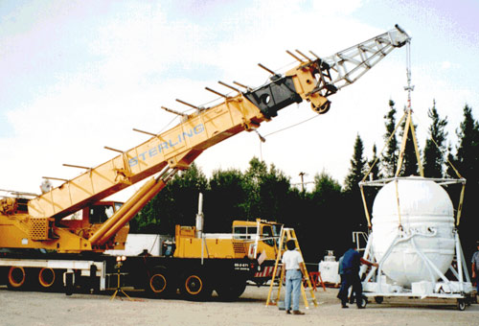
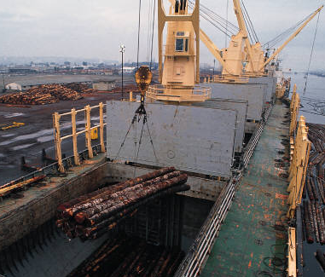
More examples
⬅ Sails and fishing nets
⬅ Cranes ⬇
+ clothes lines
+ gym training equipment
+ rock climbing gear

Slide 7
Why use pulleys?
Makes lifting things easier
Pulleys redirect force
Enables us to use gravity to help us (it is usually easier to full down than to lift something up)
Using several pulleys reduces the force required to lift an object
We have to use more rope and make the rope go further
Mechanical Advantage: More distance traveled, but less force required

Slide 8
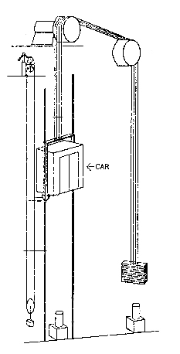
Using Gravity
Elevator Pulleys
Easier to pull down than up
Elevators use gravity
Counterweight on the other side of the cable
Gravity already applying force on counterweight
Less powerful motor required
Counterweight

Slide 9

System of Pulleys
The force needed
to raise this weight
is ¼ the weight of
the object
Weight

Slide 10
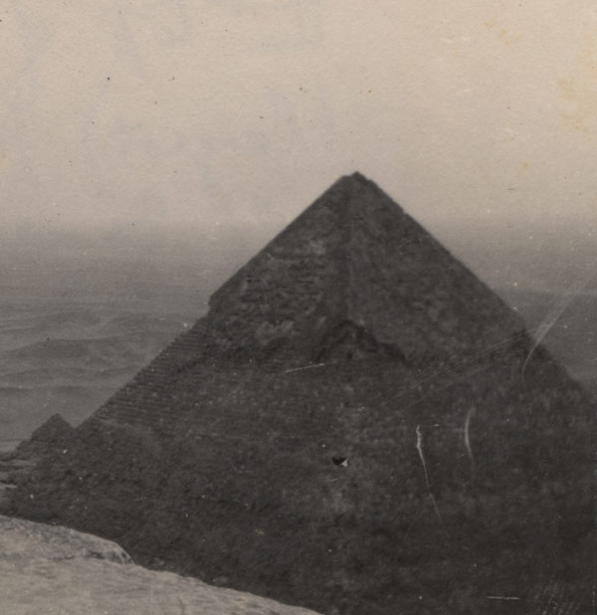
How do they help us?
How do they help us build the pyramids?
Block
Pull Here

Slide 11
Building the Pyramids

Slide 12
Vocabulary & Definitions
Force: A push or pull on an object.
Fixed pulley: A pulley attached to a fixed point with the rope attached to the object.
Movable pulley: A pullet attached to the object itself, with one end of the rope attached to a fixed point.
Redirect force: To change the direction of a push or pull to gain advantage over a task.
Mechanical advantage: The advantage gained my using simple machines; trading distance for force.

Slide 13
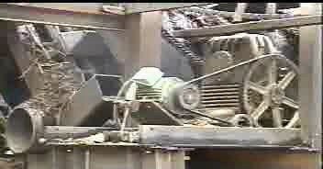
References
Drawing of block and tackle (right) is Copyright © U.S. Department of Transportation, Federal Highway Administration, Handtools for Trailwork, http://www.fhwa.dot.gov/environment/fspubs/05232810/page16.htm
Photo of Giza pyramid (right) is Copyright © National Library of Medicine, Profiles in Science, The Wilbur A. Sawyer Papers, http://profiles.nlm.nih.gov/LW/B/B/D/Y/
Photo of crane (right) is Copyright © NASA, Nightglow, Interesting Vehicles, http://nightglow.gsfc.nasa.gov/vehicles.html
Drawing of mine elevator (right) is Copyright © U.S. Department of Labor, Mine Safety and Health Administration, http://www.msha.gov/S&HINFO/TECHRPT/HOIST/PAPER4.HTM
The photo of an unguarded belt and pulley (right) is Copyright © U.S. Department of Labor, OSHA, http://www.osha.gov/SLTC/woodproducts/pulley.html.
The hand and pulley photograph (right) is Copyright © Denise Carlson, ITL Program, College of Engineering and Applied Science, University of Colorado at Boulder. Used with permission.
Pulley concept drawings are Copyright © ITL Program, College of Engineering and Applied Science, University of Colorado at Boulder.
The rest of the images are Copyright © 2004 Microsoft Corporation, One Microsoft Way, Redmond, WA 98052-6399 USA. All rights reserved.

